Slide 1
Welcome to hps 250
Course instructor: Jamie shaw

Slide 2
Course structure
Essay
How to write a professional academic paper.
Case Study Assignments
The text has many excerpts from famous scientific texts. These must be reconstructed into an argument.
Participation
Tutorial, lecture participation (asking questions), extra-curricular participation (questions about the course content over email or attending office hours).
Final Exam
Will contain material both from the text and the lectures. The readings and attending the course are mandatory for doing well on the exam.

Slide 3

Course overview
Scientific methodology?
  Is there such a thing as ‘the scientific method’? If so, what is this method?
  What is the relationship between observation and scientific theories?
  Are there objective facts?
Science and Society
  What is the relationship between science and society?
  What is the role of scientific experts?
  Should we believe what there is a scientific consensus on?

Slide 4
Scientific method
What is a method?
It’s a way of getting from A to B. If you want to get to a grocery store, then A is your home, B is the grocery store and your method might be walking, driving, bicycling, etc.
In this example, there are many methods and you can have mixed methods (i.e., you can walk part of the way and drive the rest).
But scientific method is supposed to be different
Scientific Method
There is only one (for some).
A and B are much more abstract.

Slide 5
Scientific method cont’d
Options for A:
Rationalism: All science is grounded in self-evident, obvious truths (“axioms”).
Empiricism: All science is grounded in sense-experience
Fideism: All science is grounded in faith
Options for B:
Realism: Knowledge about the structure of the world
Instrumentalism: Knowledge about how to predict and manipulate the world
Kantianism: Knowledge about how the world appears to us.

Slide 6
Rationalism
Rene Descartes
What can we know with certainty?
NOT sense experience
NOT our ordinary beliefs and conventions.
We know certain truths that cannot be doubted.
Examples of self-evident truths: the law of non-contradiction, the law of identity, the universe is continuous with itself, things can’t exist and not exist at the same time, every effect has a cause.

Slide 7
Empiricism
John Locke
We only know things from experiencing facts about the external world.
Experience creates imprints in our minds, then we can reason about them.
All truths are reducible to experience
David Hume
Flames quote.
Many ideas that we hold we cannot know from experience (e.g., causation)

Slide 8

Fideism
All knowledge is ultimately grounded in faith (not necessarily religious faith)
Pascal: all reason can be doubted and experience can be misleading. We must have faith, take a guess, at something in order to reason at all.
Kierkegaard: Reason and experience can only take us so far. It’s like climbing a mountain where we must take a “leap” to finish the goal.

Slide 9
Realism
The world is the way our best scientific theories says it is
  Species evolve by natural selection
  Space-time is curved
  Earthquakes are caused by shifts of tectonic plates
Argument: These theories are amazingly predictively accurate in all sorts of surprising ways. It would be a miracle if the world just so happened to conform to our theories predictions, over and over again, if it wasn’t structured the way our theories say it is.

Slide 10
Instrumentalism
Predictions are really useful in all sorts of ways.
Theories that we used to think were true, and were successful, turned out to be false
  Phlogiston theory
  Crystalline spheres
  Aether theories of light
Theories may not give us knowledge of the world. They do give us useful tools for predicting and manipulating the world.

Slide 11
Kantianism
The human limits what we can possible know. We can only know how things appear to us. Science is about systematically evaluating appearances. How reality is in itself is unknowable to us.

Slide 12
Scientific method revisited
What is the missing link between A and B?
  Induction: We start from sense experience and generalize to theories.
  Falsificationism: We start with conjectures (guesses) and try to falsify them.
  Anarchism: There is no scientific method. Science is about playing around with ideas
  Pluralism: There are many scientific methods, and none of them are more important than the others
  Relativism: There is no scientific method. Science is an irrational activity that is determined by psychological and sociological causes.
  We will talk about paradoxes that come up when we outline these views

Slide 13
Scientific method cont’d
Two broad ways of thinking about what scientific method is:
  1) Scientific method is about the structure of arguments. Fundamentally, scientific method is a type of logic.
    The truth of falsity of a claim does not depend on who makes it. It is objective as long as the method is followed.
  2) Scientific method is a practice. It is something humans do
    The truth or falsity of a claim depends on who makes it.
    Tversky and Kahneman: human reasoning is very different from ‘Reason.’ Similarly, scientific practice is very different from ‘Scientific Method.’

Slide 14
Naturalism and scientific method
Naturalism: Everything that exists, exists in nature.
  Science is not some abstract set of arguments. Abstract things don’t exist! Science is a practice of human beings and instruments that interact with the external world.
  Instead of looking at the structure of arguments, we look at how science is done. Philosophy is mixed with other sciences: how does scientific reasoning work in industrial societies? How does ones gender or race influence their approach to science? How do communities organize to produce science?
  We will look at arguments from this perspective. Most of the time, these views conclude that there is no one thing ‘science’ nor is there one ‘scientific method.’

Slide 15
Science and society
Science has played different roles in different societies. We will focus on the roles science plays in democratic societies. This includes the following topics:
  Who are the relevant experts when constructing policy? Who counts as an expert and why?
  Should we trust what the experts tell us? Should non-scientists participate in the production of science?
  What is the role of science in a ‘post-truth’ world?
  Who should choose what science gets funded? The people, or the scientists themselves?

Slide 16
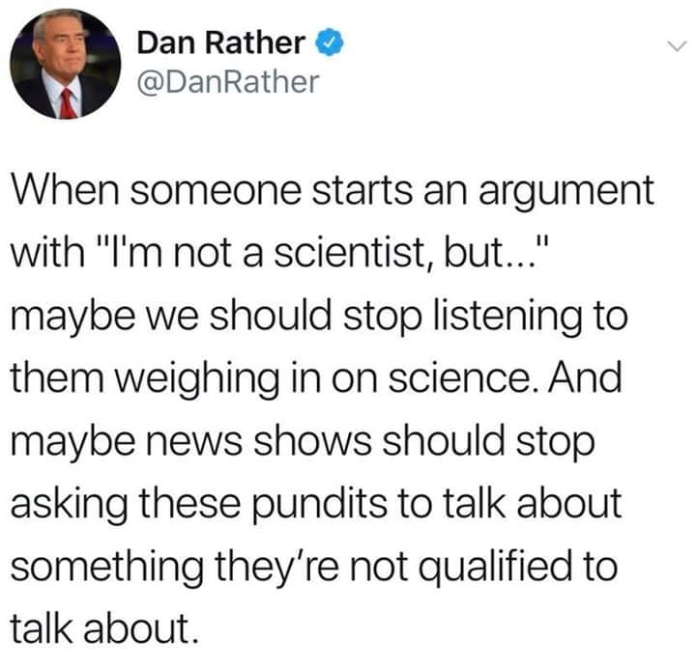
A naïve view of scientific expertise

Slide 17
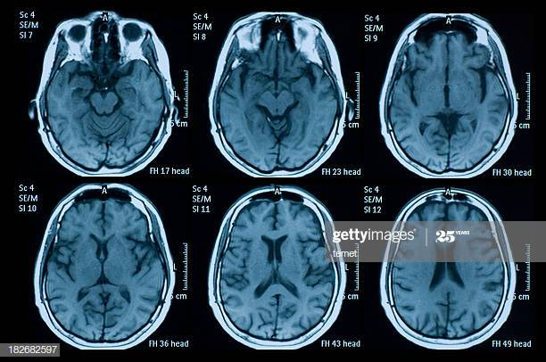
Questions for this view
Who gets to count as an expert?
  Problem of diversity: Different experts have different opinions.
  Problem of domain: Figuring out what the relevant domain is incredibly difficult.
  Problem of institutional bias: What are the markers for a legitimate expert?
  Problem of values: If scientists make value judgments during their science, should we trust them if they don’t share our values?
  Problem of Isolation: If experts only talk to other experts in their fields, they don’t have their views criticized from diverse perspectives. Should their views be trusted in these cases?
Conclusion: We defer to experts because we lack knowledge, but we need lots of knowledge to figure out who the experts are!

Slide 18
Freedom of science
Vannevar Bush:
“Science proceeds on a broad front by the free play of free intellects, working on subjects of their own choice, in the manner dictated by their curiosity for exploration of the unknown” (Bush 1945, 12)
Scientists should be free to pursue whatever science they think is important.
This does not mean free to conduct experiments that are harmful, for example.
The idea is that science is valuable, and scientists know best how to prioritize science. So they should get to choose what science gets done

Slide 19
Social responsibility of science
Science is only valuable because scientific knowledge is useful.
Science should pursue knowledge that is valuable.
Value should not be determined by scientists but, in a democracy, by the people

Slide 20
Democracy and science
Do democracy and science go together?
Two arguments:
  Science is about following a method objectively. It shouldn’t be swayed due to popular opinion
  Science needs to produce socially responsible truths that we can trust. To do with, we need to integrate science with other parts of societies:
    Example: AIDS activism and clinical trials

